Slide 1
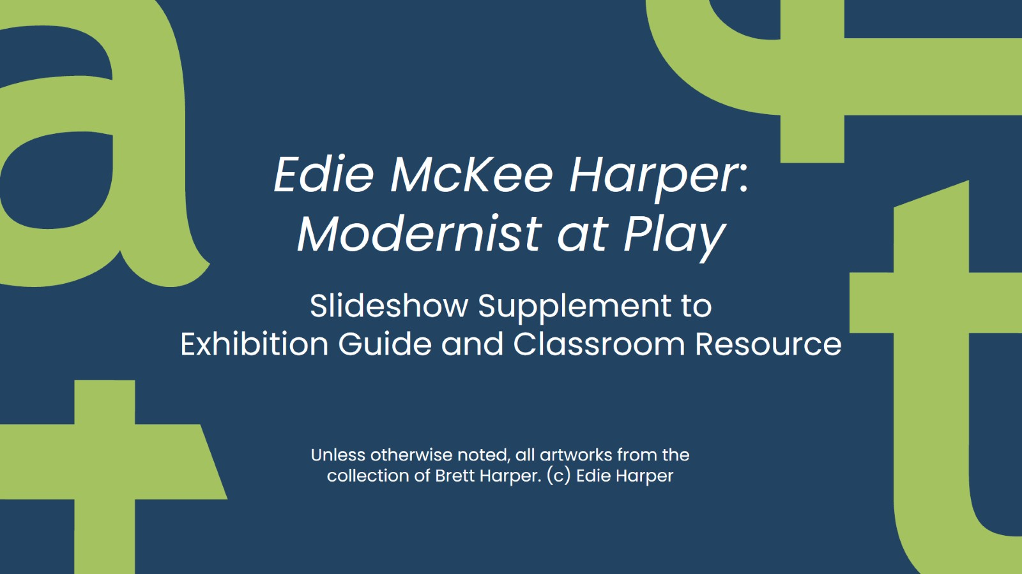

Slide 2
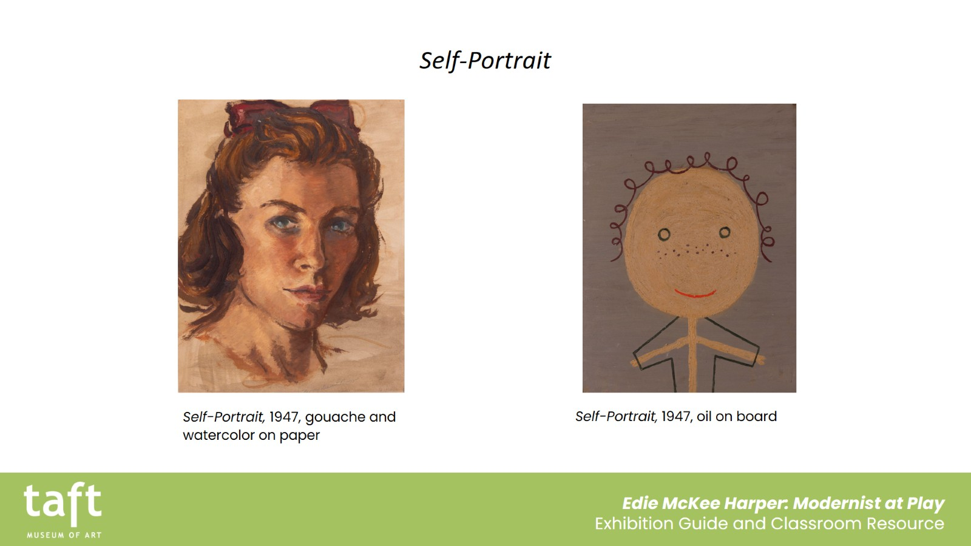
Self-Portrait

Slide 3
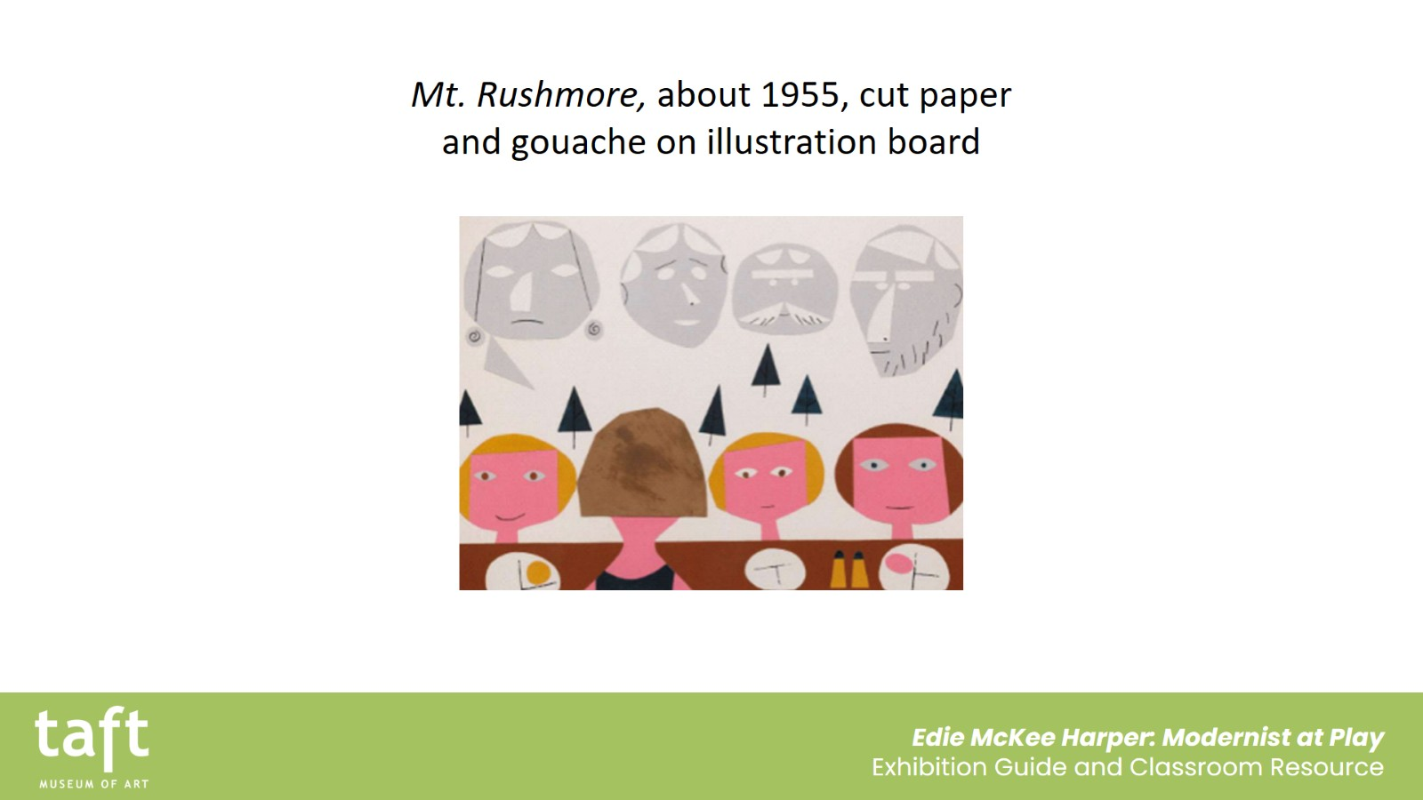
Mt. Rushmore, about 1955, cut paper and gouache on illustration board

Slide 4
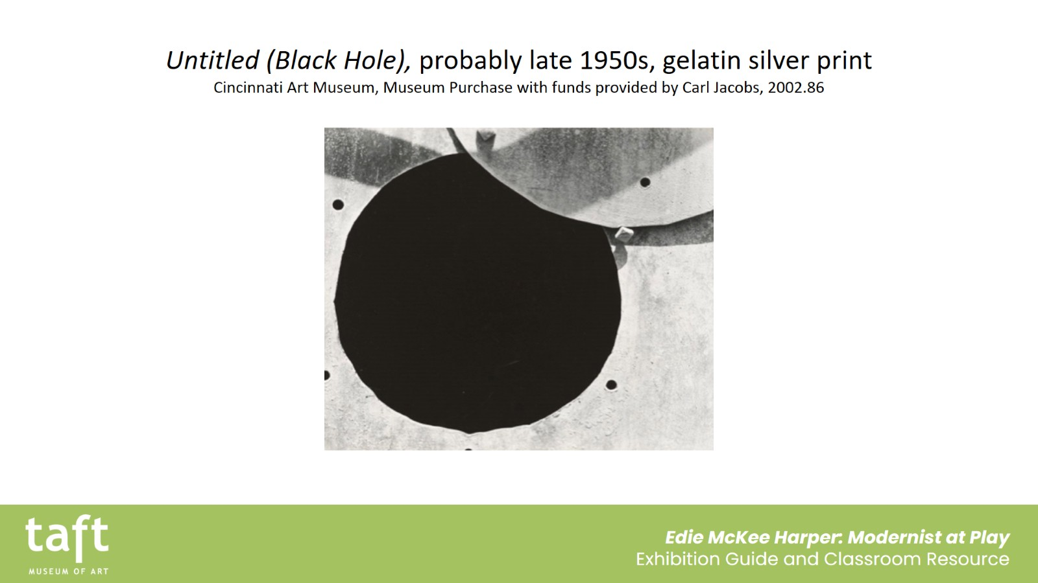
Untitled (Black Hole), probably late 1950s, gelatin silver print
Cincinnati Art Museum, Museum Purchase with funds provided by Carl Jacobs, 2002.86

Slide 5
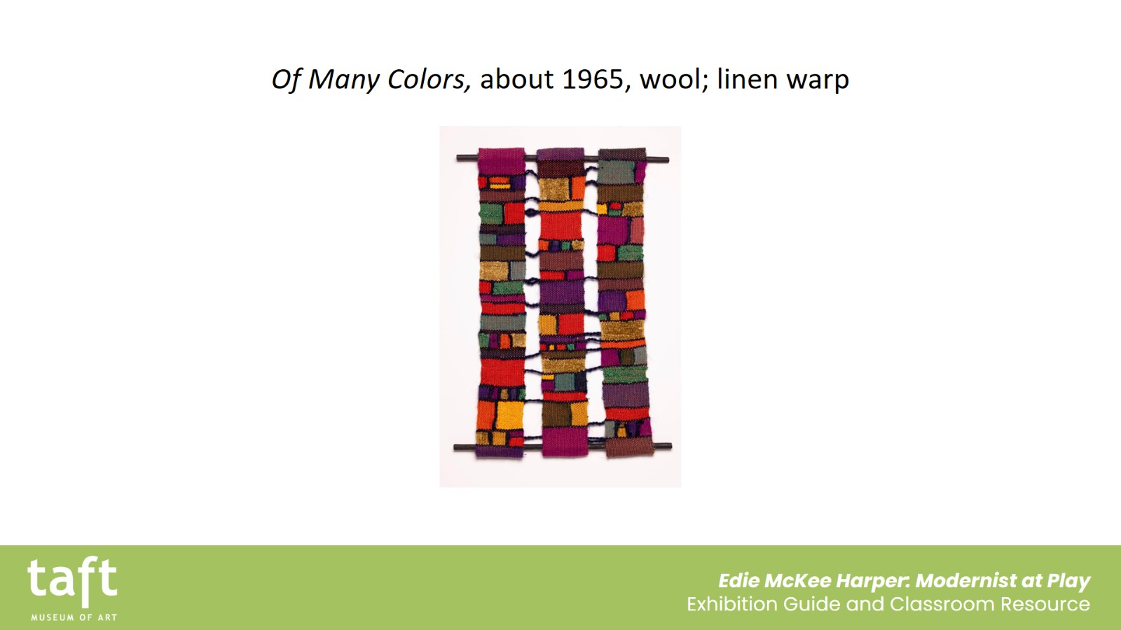
Of Many Colors, about 1965, wool; linen warp

Slide 6
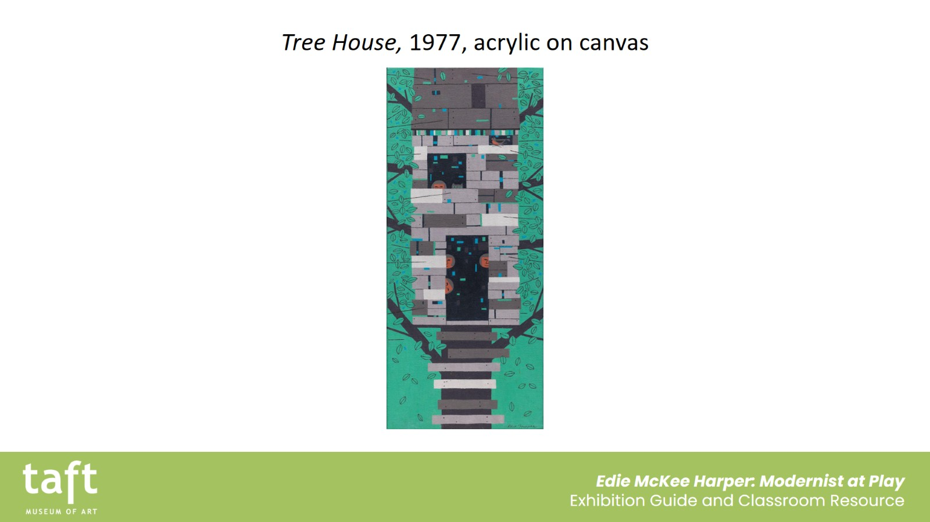
Tree House, 1977, acrylic on canvas

Slide 7
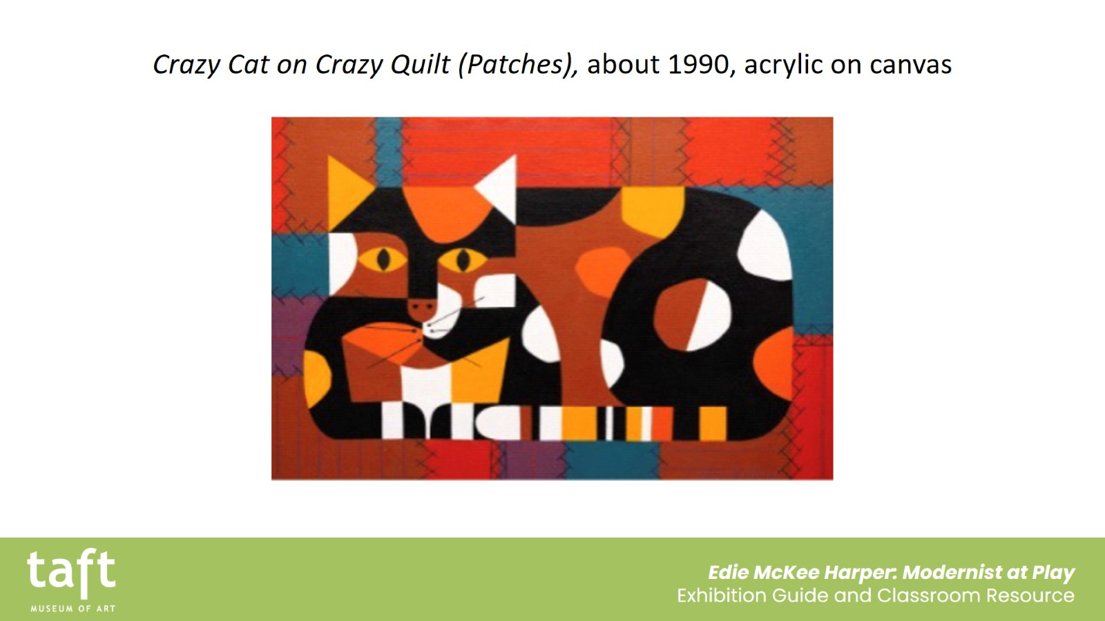
Crazy Cat on Crazy Quilt (Patches), about 1990, acrylic on canvas

